Slide 1
Truth or Consequences A Discussion of Java’s Memory Model
Steven K. Andrianoff, Joe Kmoch, and David B. Levine

Slide 2
Motivation
Inspired by a talk at NECC, June, 2003
entitled “Java Gotchas” by Tom West
Many of the “gotchas” were caused by a lack
of understanding of Java’s use of memory
This matched our experiences learning Java and
those of our students

Slide 3
Today’s Approach
Examine some areas where a misunderstanding of the model may cause a student (or teacher) to be puzzled by a program’s behavior
Philosophize a bit
Show examples
Explain principles

Slide 4
Today’s topics
Creating objects
Testing objects for equality
Passing parameters (by value)
Casting
Dealing with linked structures

Slide 5
On Creationism
“There is nothing new under the sun but there are lots of old things we don't know.”
Ambrose Bierce
The Devil's Dictionary
“If you want to make an apple pie from scratch, you must first create the universe.”
Carl Sagan

Slide 6
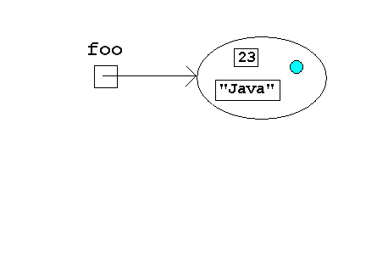
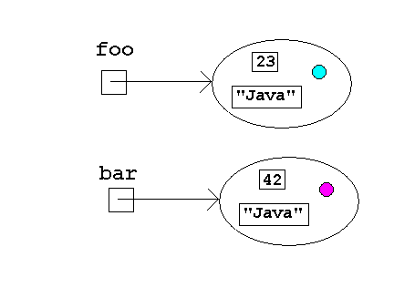
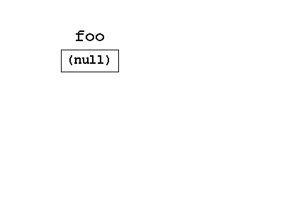
Creating Objects
Widget foo;
Widget foo(23,”C++”,Color.RED);
foo = new Widget(
23, “Java”,
Color.CYAN);
Widget bar =
new Widget(
42, “Java”,
Color.MAGENTA);
ERROR!!!!

Slide 7
Creating Objects in Java
Objects in Java are created ONLY through the use of the new operator
A declaration of a variable in Java creates a reference (initially null) to an object of the declared type

Slide 8
On Equality
“All animals are equal but some animals are more equal than others.”
George Orwell
Animal Farm
“I never said that I treat my children equally; I do, however, try to treat them fairly.”
Ann Levine
(Dave’s Mother)

Slide 9
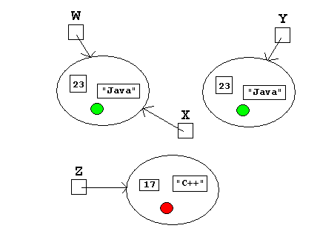
Memory and Equality
true expressions
W == X
W.equals(X)
X.equals(Y)
false expressions
W == Z
W.equals(Z)
X == Y

Slide 10
Equality in Java
Java supports two kinds of equality
Equality of identity – two references refer to the same object
This is the meaning of the == operator
Equality of content (equivalence) – two references refer to object(s) with the same content
This is the purpose of the equals() method

Slide 11
On Names
“The name of the song is called "HADDOCKS' EYES."'
`Oh, that's the name of the song, is it?' Alice said, trying to feel interested.
`No, you don't understand,' the Knight said, looking a little vexed. `That's what the name is CALLED. The name really IS "THE AGED AGED MAN."'
`Then I ought to have said "That's what the SONG is called"?' Alice corrected herself.
`No, you oughtn't: that's quite another thing! The SONG is called "WAYS AND MEANS": but that's only what it's CALLED, you know!'
`Well, what IS the song, then?' said Alice, who was by this time completely bewildered.
`I was coming to that,' the Knight said. `The song really IS "A-SITTING ON A GATE": and the tune's my own invention.‘”
Lewis Carroll
Through the Looking Glass, Chapter 8

Slide 12
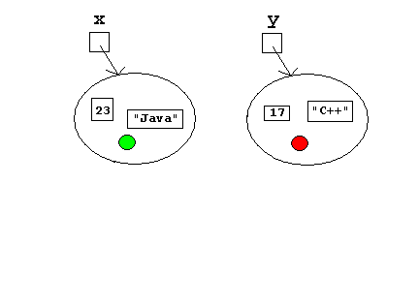
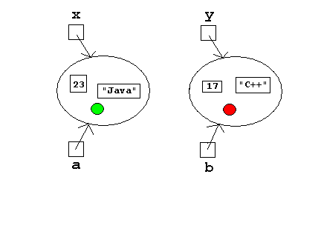
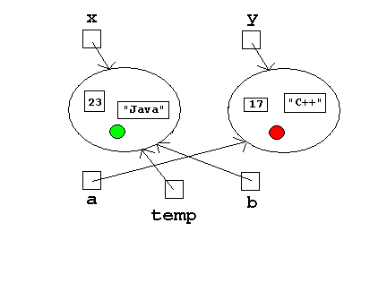
“Swapping” Object References swap(x,y)
public void swap
(Object a, Object b)
{
Object temp = a;
a = b;
b = temp;
}
Before invocation
At beginning of invocation
At end of invocation
After invocation

Slide 13
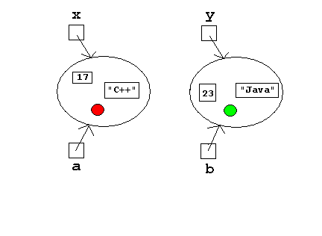
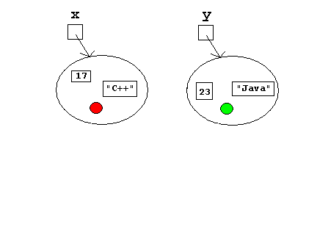
“Swapping” Object Contents swap(x,y)
public void swap
(Object a, Object b)
{
…
a.setContents(
b.getContents());
…
}
At beginning of invocation
At end of invocation
Before invocation
After invocation

Slide 14
Parameter Passing in Java
ALL Parameters in Java are passed by value!
This is easy to understand for primitive data types (see C++)
It is also easy to understand for objects IF you keep the model in mind

Slide 15
On Casting
“The glorious gifts of the gods are not to be cast aside.”
Homer
The Iliad
“Education is the process of casting false pearls before real swine.”
Irwin Edman
Columbia University

Slide 16
Casting About
ArrayList a = new ArrayList();
String s = new String(“Hello”);
a.add(s);
System.out.println( a.get(0).length() );
System.out.println(((String) a.get(0)).length() );
String t = (String) a.get(0);
System.out.println(t.length() );
ERROR! ArrayList’s get() returns an Object – which does not have a length() method!
OK! The value returned by get() is cast to a String – which does have a length() method!
CLEARER STILL?

Slide 17
Types in Java
Objects (of derived classes) have more than one type; in particular, they are instances of each class in the inheritance chain
The compiler will only permit method invocation if the (believed) type supports that invocation.
Casting is a promise to the compiler that an object has a given type.

Slide 18
On Keeping Your Head
“I'm going to memorize your name and throw my head away.”
Oscar Levant
“I think that I shall never see a structure lovely as a tree.”
AP T-shirt (Fran Trees, 1989)
inspired by Joyce Kilmer

Slide 19
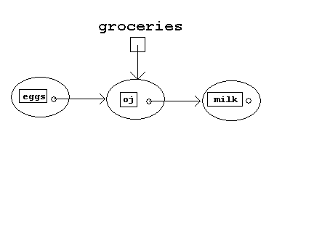
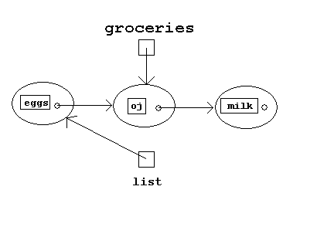
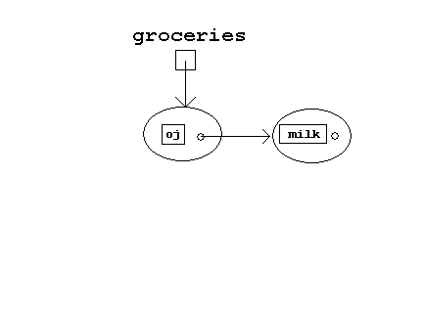
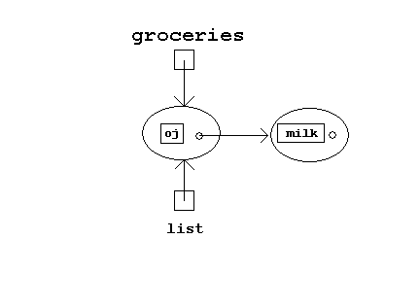
Adding to a list:
insert(groceries,”eggs”);
public void insert(
GroceryList list,
String food)
{
list = new GroceryList
(list, food);
}
After invocation
At end of invocation
After garbage collection
Before invocation
At beginning of invocation

Slide 20
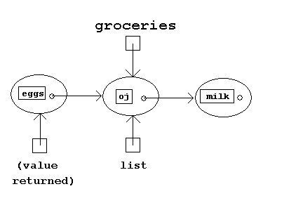
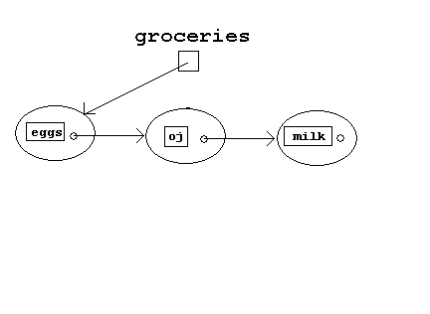
Adding to a list:
groceries = insert(groceries,”eggs”);
public GroceryList insert(
GroceryList list,
String food)
{
return new GroceryList
(list, food);
}
Before invocation
At beginning of invocation
At end of invocation
After invocation (and assignment)

Slide 21
On Keeping Your Head in Java
If a method modifies a structure that is a parameter, then the method should return the modified structure.
Good class design can avoid this problem in many cases.

Slide 22
On Life with Java?
“What a waste it is to lose one's mind. Or not to have a mind is being very wasteful. How true that is.”
J. Danforth Quayle

Slide 23
In the End
All of the “gotchas” in this talk can bite – and hurt when they do.
All can be avoided by keeping track of the programming (memory) model being used.
The model is consistent (and simple), but it is not the one used by C++!

Slide 24
<insert pithy closing quote here>

